Slide 1
Utilization of Recycled Concrete Aggregates in Construction Industry for Sustainable Development
Dr. Mehrnoush Khavarian
School of Architecture and Built Environment
University of Newcastle

Slide 2
Research Group
Dr. Patrick Tang
Associate Professor & Group Leader
School of Architecture and Built Environment
Dr. Igor Chaves
Senior Lecturer
School of Engineering (Civil Engineering)
Dr. Willy Sher
Associate Professor
School of Architecture & Built Environment
Dr. Jianglong Yu
Professor School of Engineering (Chemical Engineering)
Dr. Mehrnoush Khavarian
Research Fellow
School of Architecture and Built Environment
Dr. Yanju Liu
Senior Research Fellow Environmental Chemistry
Ali Yousefi
PhD Candidate
School of Architecture and Built Environment

Slide 3
Research Area of Our Group
Major Research Area which are not limited to:
Environmental Sustainability
Construction Technology
Concrete Technology & Design
Structural Retrofitting
Research Area
Building Materials
Building Maintenance
Recycled Aggregates
Building Materials

Slide 4
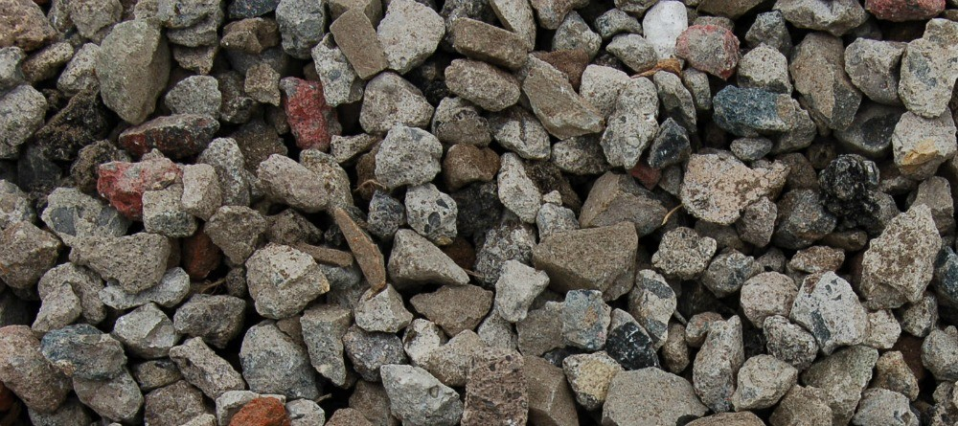
Recent Related Achievements
Recent Grants Related to the Use of Recycled Aggregates in Concrete:
Title: Optimizing use of recycled aggregates in concrete production and application
Funding body: Cooperative Research Centers (CRC grants, 2020-2024)
Title: To identify and validate new recycled concrete aggregates and sands for the construction industry
Funding body: Concrush Pty Limited and Department of Industry, Innovation and Science (2018-2019)
Title: Experimental studies on self-compacting concrete utilising recycled aggregates
Funding body: Faculty of Engineering and Built Environment- The University of Newcastle (2017-2018)
Related Industrial Partners
Concrush Pty Limited
Daracon/Daracrete Group
W&G Duber Design &Construction
Great Lakes Concrete

Slide 5
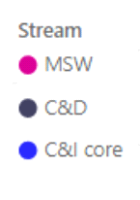
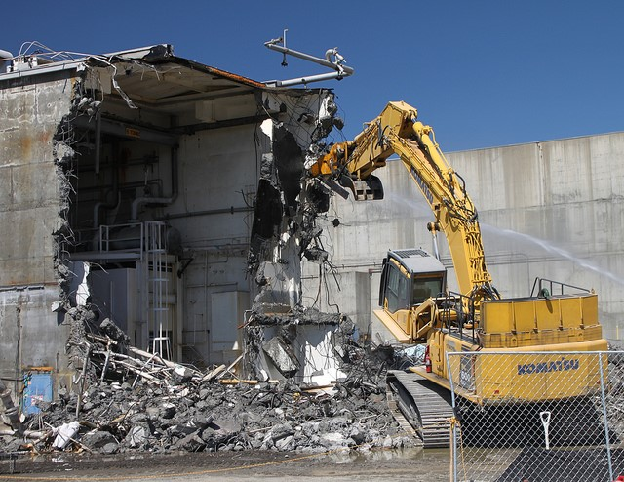
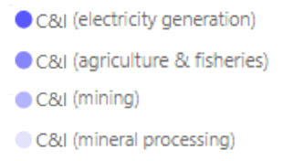
Construction and Demolition (C&D) Wastes
Waste generation by stream in Australia 2016-17
C&D
18%
In 2016-17, there was about 20.4 Mt wastes from the C&D sector.
Stream
Concrete waste
About 81% of the C&D wastes are related to waste concrete (~16.5 Mt) which about 72% of them are recycled.

Slide 6
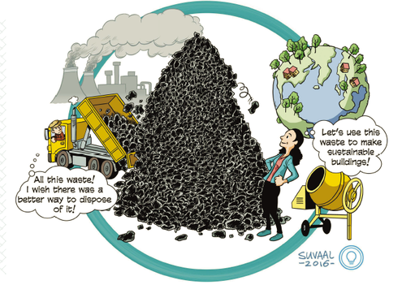

Slide 7
Value Engineering Benefits
Circular economy concept highlights the notion of replacing the end-of-life in current production and consumption practices by reducing, reusing and recycling products and materials in production, distribution and consumption processes.
Circular Economy
Linear Economy
The benefits of using recycled concrete aggregates
Avoids haul-off costs and landfill disposal fees
Eliminates the expense of aggregate material imports and exports
Reduces the environmental impact of the aggregate extraction process

Slide 8
Obstacles in Use of RCA
Technical problems associated with recycled concrete aggregates
Reduction in workability of concrete
Higher porosity and lower strength than natural aggregate
Large and variable drying shrinkage implications
Poor grading and large variation in quality
Limited application of RA in non-structural concrete, base and subbase for road pavement and drainage backfill material.
Lack of guidelines, specifications, standards, data base to use RA in construction industry of Australia.

Slide 9
Treatment Options in Literature
Treatment Methods:
Pre-soaking in water
Mechanical screening
Surface modification
Milling/Grinding
Coating and impregnation
Pre-soaking in acid
Ultrasonic cleaning
Carbonation
Freeze–thaw method
Microwave process
Treatment methods are based on:
Removing the adhered mortar or
Strengthening the recycled concrete aggregates structure
Natural Aggregates
Mortar
RCA

Slide 10
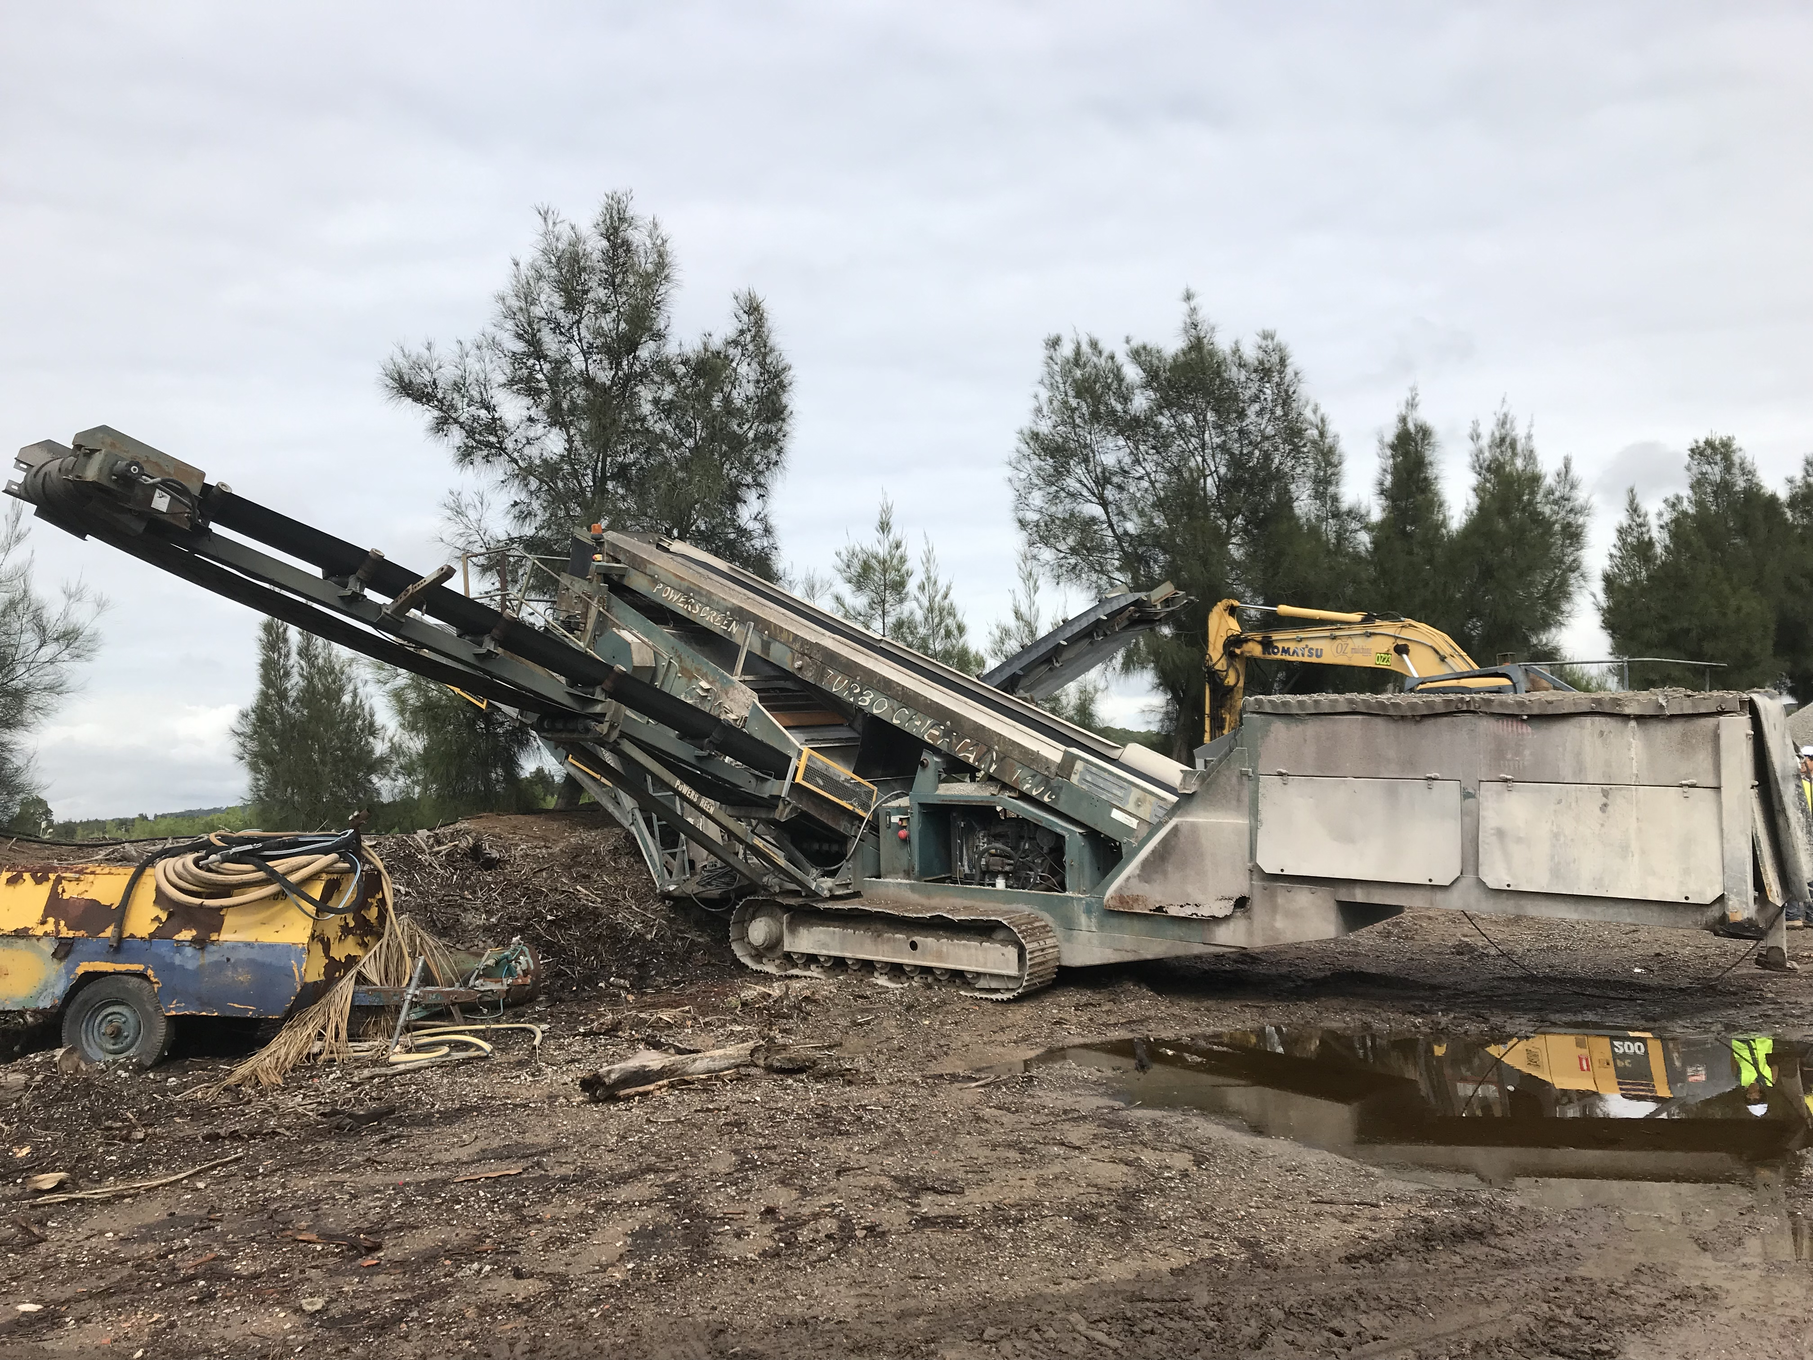
Suggested Treatment Method
Amongst suggested methods, screening and pre-soaking in water are:
more practical in the construction industry in terms of economic and environment aspects
contributed in less energy consumption in compare with thermal and chemical treatment

Slide 11
Aims and Objectives
To investigate the feasibility of screening and pre-soaking methods as a potential solution for the production of high-quality recycled aggregates-concrete.
To study water absorption, particle size distribution and crushing value of recycled concrete aggregates.
To measure the fresh and hardened properties such as workability, shrinkage,, compressive and tensile strengths, elastic modulus and microstructure behaviour of recycled aggregates-concrete.
To investigate the influence of the numbers of screening and replacement levels of RCA on the properties of concrete mixes.

Slide 12
Characterization of Recycled Concrete Aggregates

Slide 13
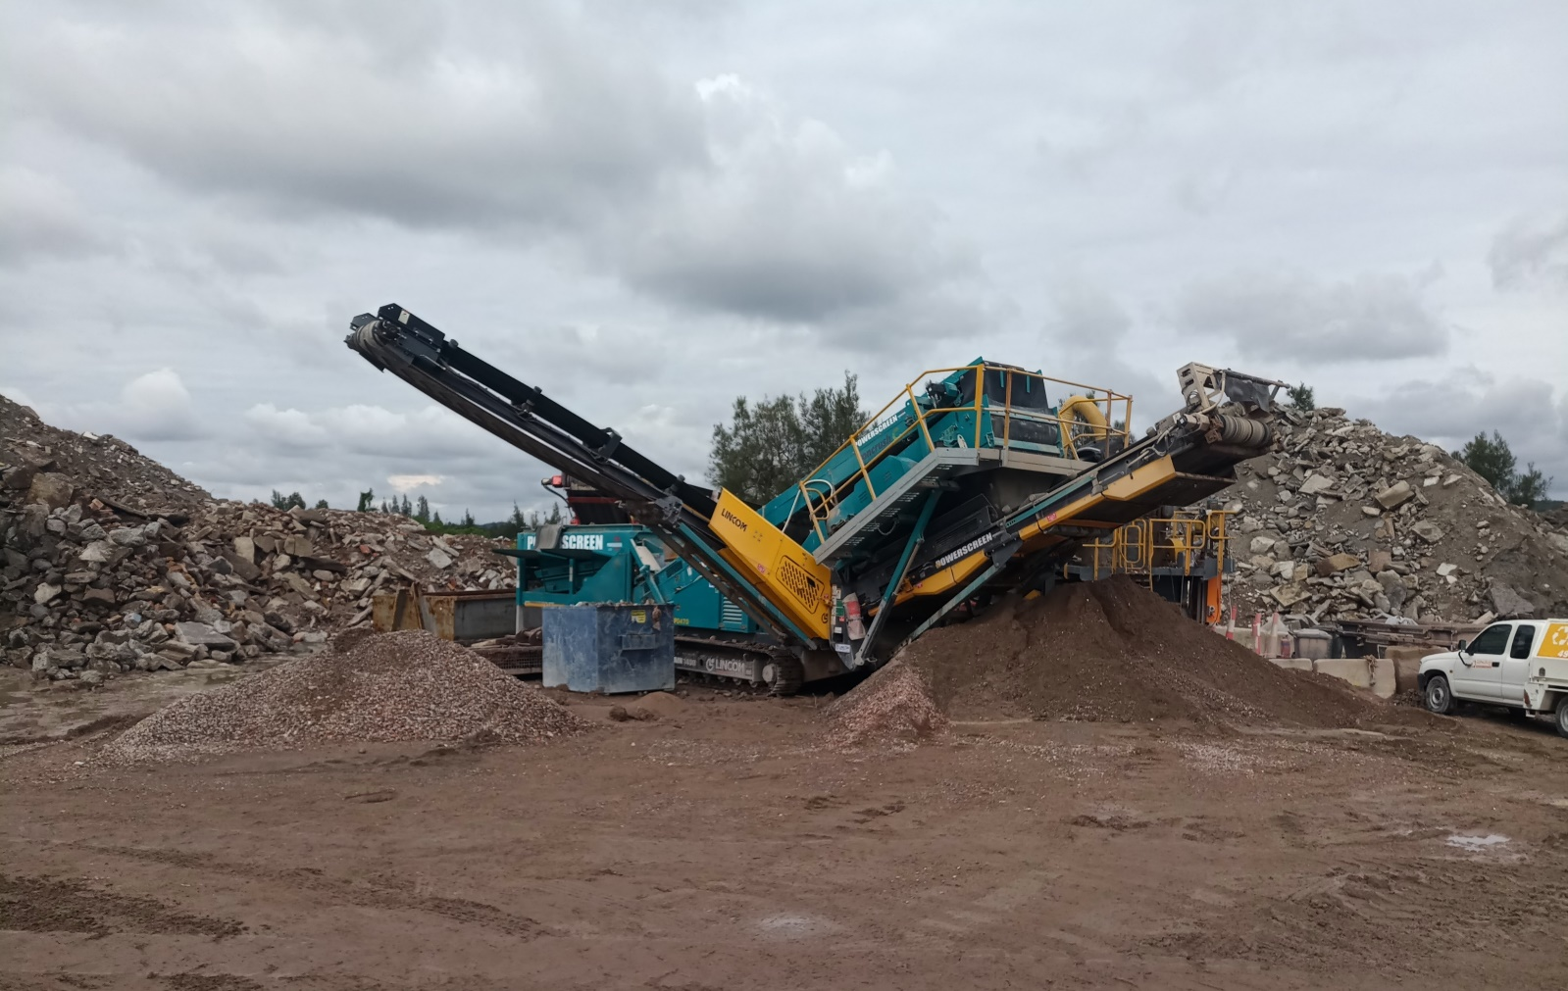
Screening Process
In our project, two types of recycled aggregates from different waste sources were studied.
One of them generated from a higher quality waste source (1SRCA) with once screening,
and another type (RA) were screened four times.
Unscreened (0SRA) – 10mm aggregates
Screened once (1SRA)
Screened twice (2SRA)
Screened four times(4SRA)
Screened three times(3SRA)
3000 kg (0 % mass loss)
2500 kg (7.8 % mass loss)
2300 kg (13.3 % mass loss)
2100 kg (16.7 % mass loss)
2050 kg (17.8 % mass loss)
Strat position: screen size 14 mm
End position: screen size 7 mm
Screening Machine (Concrush Co.)

Slide 14
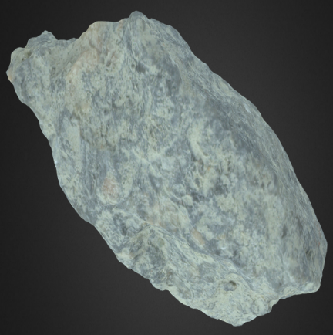
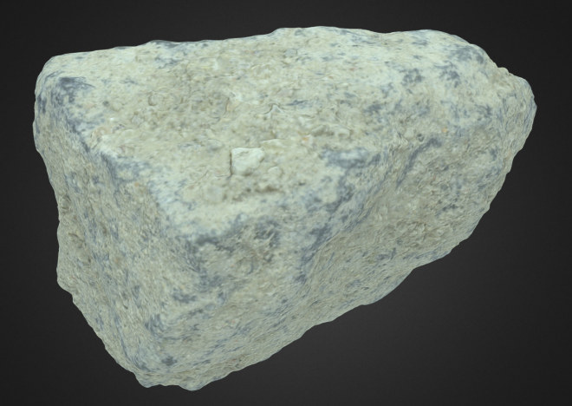
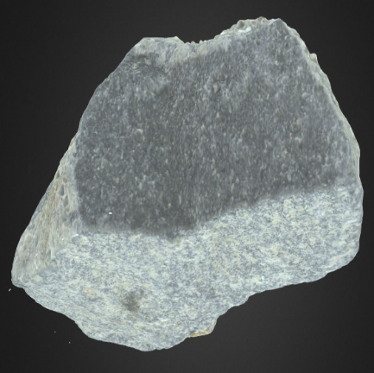
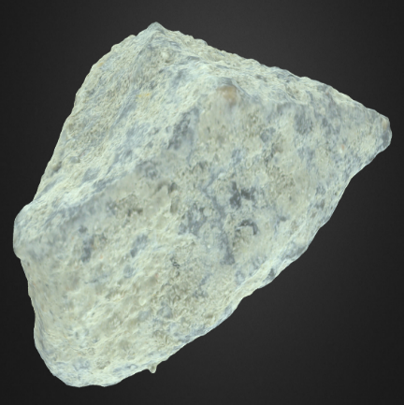
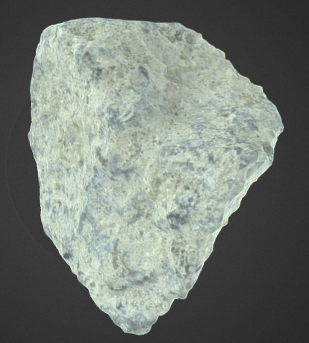
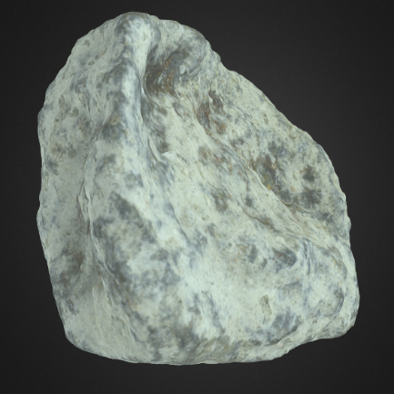
3D Model Observation
NA
0SRA
1SRA
1SRCA
3SRA
2SRA
4SRA

Slide 15
Particle Size Distribution
Fine Sand
Coarse Sand
20mm NA
10mm Na
0SRA
1SRA
2SRA
3SRA
4SRA
1SRCA
Standard: AS1141.11.1

Slide 16
Water Absorption Test Results

Slide 17
Crushing Value Test
Standard: AS1141.21

Slide 18
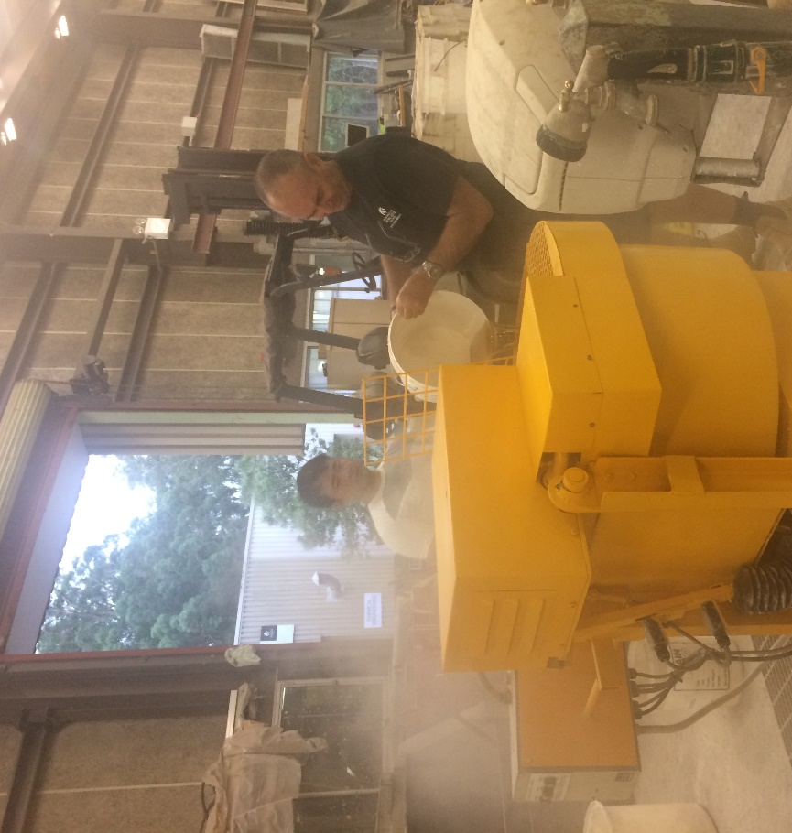
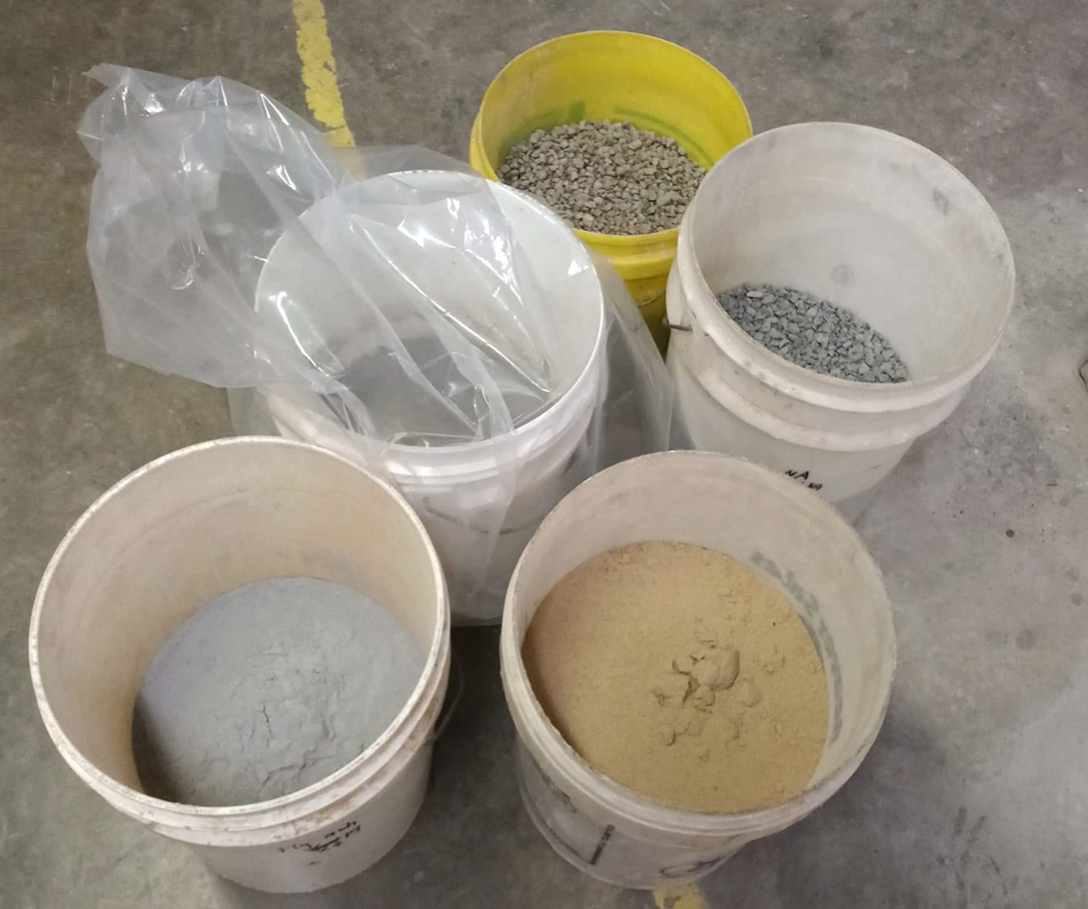
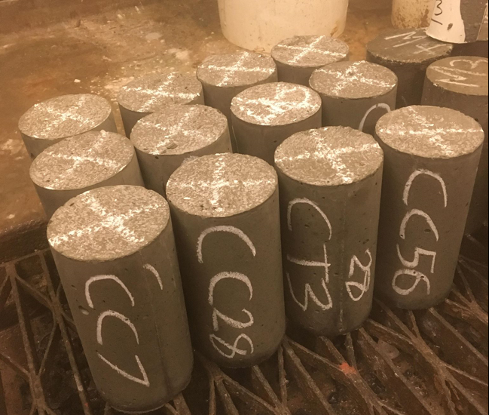
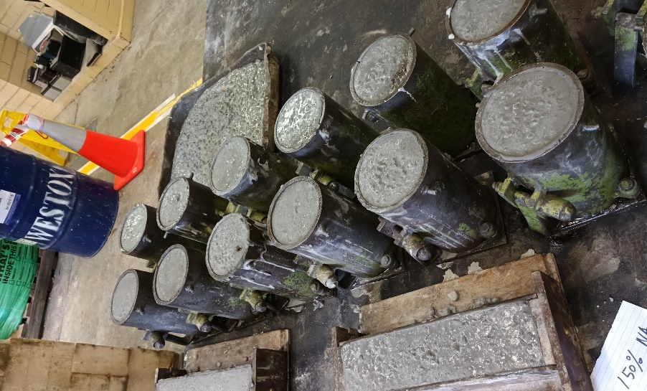
Mixing Procedure
The mixing procedure of RA concrete is the same as conventional concrete, however RA is pre-soaked in water for 3 minute and then allow them to be air-dried till SSD is achieved prior the mixing procedure.
Materials Preparation
Mixing Process
Cast moulds
Samples

Slide 19
Mix Proportion for 1m³ Concrete
No | Mixing Code | Cement (kg) | Fly ash (kg) | 20mm NA (kg) | 10mm NA (kg) | 10mm RCA (kg) | Fine Sand (kg) | Coarse Sand (kg) | Water (L) | S.P (mL)
1 | C.S | 410 | 120 | 720 | 280 | 0 | 350 | 265 | 205 | 1800
2 | 0SRA100 | 410 | 120 | 0.0 | 0.0 | 1000 | 350 | 265 | 205 | 1800
3 | 1SRA100 | 410 | 120 | 0.0 | 0.0 | 1000 | 350 | 265 | 205 | 1800
5 | 2SRA100 | 410 | 120 | 0.0 | 0.0 | 1000 | 350 | 265 | 205 | 1800
6 | 3SRA100 | 410 | 120 | 0.0 | 0.0 | 1000 | 350 | 265 | 205 | 1800
7 | 4SRA100 | 410 | 120 | 0.0 | 0.0 | 1000 | 350 | 265 | 205 | 1800
8 | 1SRCA100 | 410 | 120 | 0.0 | 0.0 | 1000 | 350 | 265 | 205 | 1800
Special thanks to Daracon for its contribution in providing the mix proportion
General Purpose Cement and Fly ash provided by Boral Cement’s Blue Circle Co.
Grade: 50MPa,
Water to binder ratio (W/B): 0.39,
Replacement level of recycled aggregate: 100%
The numbers of screenings (nS): 0-4 times

Slide 20
Fresh and Mechanical Properties of Recycled Aggregates-Concrete

Slide 21
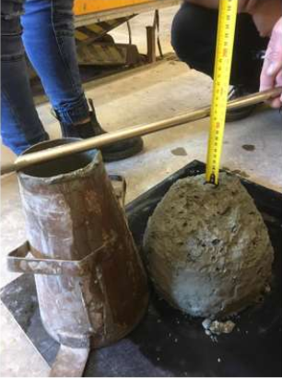
Slump Flow Test & Workability
No | Mixing code | Slump (mm)
1 | C.S | 80
2 | 0SRA100 | 100
3 | 1SRA100 | 100
4 | 2SRA100 | 100
5 | 3SRA100 | 100
6 | 4SRA100 | 100
7 | 1SRCA100 | 100
The major influencing factor for higher workability of RCA is Pre-soaking treatment of RCA in mixing procedure.
Standard:AS1012.3.5

Slide 22
Drying Shrinkage
C.S
0SRA
1SRA
2SRA
3SRA
4SRA
1SRCA
Standard:AS1012.13

Slide 23
RA Concrete Density
Standard :AS1012.12

Slide 24
Compressive Strength
Standard: AS 1012.9

Slide 25
Tensile Strength
Standard :AS 1012.10

Slide 26
Elastic Modules
Standard :AS 1012.17

Slide 27
Microstructure Observation (C.S)
Scanning Electron Microstructure (SEM)
Energy X-ray Diffraction (EDS)

Slide 28
Microstructure Observation (0SRA100)
Minor Cracks
SEM image
EDS image

Slide 29
Microstructure Behavior
1SRC100
1SRCA100

Slide 30
Conclusion
It was found that the critical influence to the performance of RA-concrete is the quality of the waste source which RA obtained from.
The size distribution results showed that unscreened RA contains a large amount of fine aggregates from crushing process with high porosity and water absorption.
Two or three times of screening is recommended to effectively remove the adhered mortar and fine aggregates from the RA.
The hydrostatic weighting method is suggested to determine the water absorption of RA instead of using the AS standard method which assigned for natural aggregates.
The calculated crushing value for all tested RA were in the standard range (20-30 %) to be used in conventional concrete.

Slide 31
Conclusion
The pre-soaking method proved to be helpful for getting better workability of concrete with very minimal bleeding effects while maintain a desirable compressive strength.
The complete replacement of coarse sand can produce standard grade concrete of 40MPa, but cannot achieve high grade concrete. This result is still promising as many specifications for RMS roads and bridges provide an upper limit of compression of 40MPa at 28 days.
The suggested integrated pre-soaking and screening method had no remarkable effect on the densityand tensile strength and increased the module elasticity.
RA-Concrete demonstrated a good structure with minimal porous, voids and cracks along the interfacial transition zone.

